Slide 1







GEORGE WESTINGHOUSE CTE H.S.
2024-2025
New Student Parent Orientation September 12, 2024

Slide 2






Welcome Parents and Students!
September 12, 2024
Mrs. Kyleema A. Norman, I.A.
Ms. Susan Caprio Mrs. Valerie Girard Ward Mr. Nick Pillari Mr. Steven Chung

Slide 3




Mrs. Kyleema A. Norman, I.A - Principal
Ms. S. Caprio - AP of CTE, Science, and PE
Mrs. V. Girard Ward - AP of Humanities and Arts
Introductions
Mr. N. Pillari - AP of Guidance and Special Ed
Mr. S. Chung - AP of Organization and Math Ms. M. Janvier - 9th Grade Guidance. Counselor Ms. C. Rouse - Parent Coordinator

Slide 4

Vision of Westinghouse
We at Westinghouse believe that all students should experience the Pedagogy of Humanity. The Pedagogy of Humanity is an educational philosophy that is centered on each child’s skills, intrinsic value, and dignity that teaches the whole child to become the best version of themselves. It respects the tapestry of traits that we bring and share. It fosters a spirit of community service and lifelong learning. It seeks to empower students with skills that promote a solution-oriented approach to life’s challenges.

Slide 5






Portrait of a Westinghouse Student

Slide 6



Mrs. Kyleema Norman, I.A.
Contact Information
Knorman3@schools.nyc.gov
(718) 625-6130 extension 1461

Slide 7





Topics to be covered
Bell Schedule & Procedures
Guidance
GWHS Housekeeping:
Parent Communication, Social Media & Student life
Academics (including grading policy)
Extracurricular Activities
G-House Travels

Slide 8


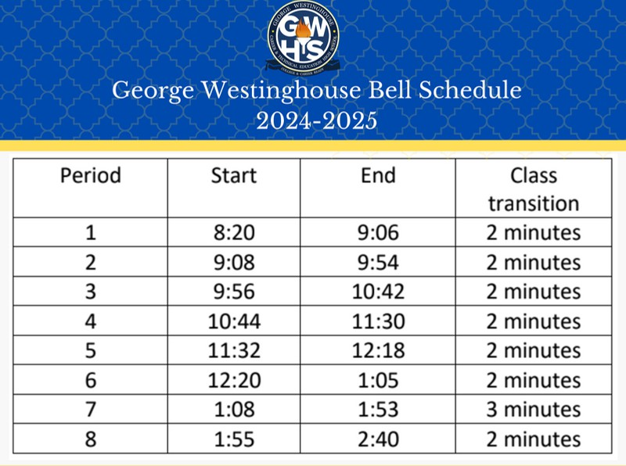


Slide 9






All students are required to swipe their school
issued ID cards upon entry.
Students must go through scanning each day.
List of Prohibited Items (next slide) Citywide Behavioral Expectations
Breakfast is served from 7:30AM - 8:20AM in the student cafeteria and is free for all students.
Students may only use the cafeteria during breakfast or their designated lunch period.
Procedures: Student Entry

Slide 10

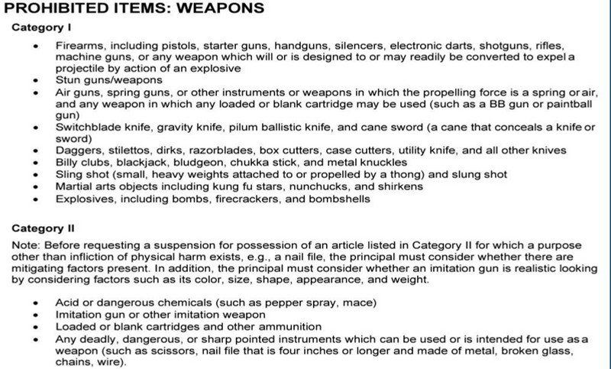


Procedures:

Slide 11








GWHS Housekeeping: Parent Communication
School Status
Communicate via home language (email or text)
Video (similar to Zoom)
Operoo
Form collection Parental permission
Emails
Automated phone calls
School Status or similar system

Slide 12



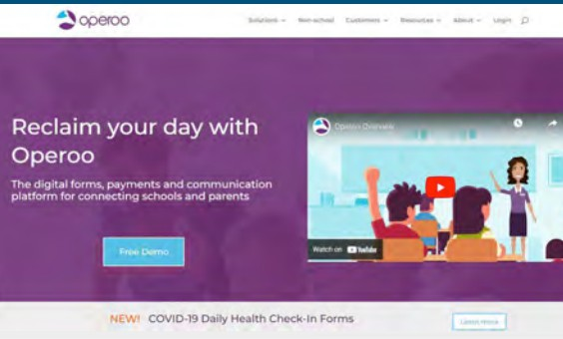

Operoo
Westinghouse utilizes a messaging and form collection system called Operoo. You will receive items such as permission requests for trips, Physical Education, general correspondence, and many more!
The system will email you every 48
hours for forms that we need such as immunization records.

Slide 13





Social Media
Website: www.westinghousehs.org
1
2
Instagram: https://www.instagram.com/westinghouse_ctehs/

Slide 14







Programs, OMNYCards, ID Cards & Lockers
Program cards will be distributed on the first day of school in the student cafeteria
Students should be prepared to show their program cards to any school
based staff member upon request
Replacement program cards will be issued by the student’s guidance counselor if needed
OMNY Cards (formerly Metrocards) will be distributed during the student’s
Math class (9th grade) or CTE class (10th-12th grade).
Replacement cards will only be issued at the end of the student’s day Lockers are not issued to students. They must purchase a lock through the parent coordinator. They will be assigned a locker to use while at Westinghouse. Lockers may not be shared.
ID cards will be issued during the first 2 weeks of school
ID cards should be presented to any school based staff member upon request
Replacements will be issued for a fee of $2.00

Slide 15





Guidance
Ms. Janvier - 9th Grade Guidance Counselor
Mjanvie@schools.nyc.gov
Mr. Pillari - AP of Guidance & Special Ed Npillar@schools.nyc.gov

Slide 16

Attendance Procedures
Attendance can be a major factor in determining student success.
Students are required to have a minimum of 90% attendance. A student with less than 90% attendance at the end of a school year is considered Chronically Absent..
An automated call goes out at approximately 10:30 AM if your child is marked absent.
Doctor's notes and letters about attendance should be turned in to the main office or counselor at the end of your day

Slide 17
Academics

Slide 18




Mrs. V. Girard Ward
AP of Humanities and Arts Vgirard@schools.nyc.gov (718) 625-6130 ext. 2123
Social Studies
(4 years = 8 Credits)
Music & Foreign Language
(1 Year = 2 Credits)
ELA
(4 years = 8 Credits)
We offer Advanced Placement Courses in Language & Composition, Literature & Composition, Env Science, World History, & US History.
We also offer College Now courses at NYC Tech College.

Slide 19






Mr. S. Chung
AP of Organization & Math Schung@schools.nyc.gov
All freshmen will take a Math and Science Regents in
June 2025.
Mathematics (4 years)
All 9th Grade Math courses are a double period.

Slide 20


Ms. S. Caprio
AP of CTE, Science, and PE Scaprio@schools.nyc.gov (718) 625-6130 ext. 2123
All 9th Grade students will take a Science Regents in June 2025..
Science (4 years)

Slide 21


Physical Education Expectations
Four years of Physical Education (gym, weight room, or fitness room).
All students will receive a school lock (red) to be used for a locker only during the physical education period.
All students must be prepared for Physical Education.
  Sneakers, sweatpants or shorts, short sleeve or gym appropriate top.
  No boots, crocs, slippers, jeans or winter outerwear will be allowed

Slide 22




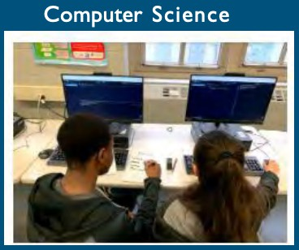
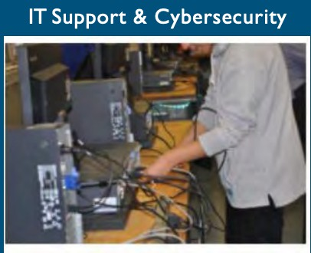
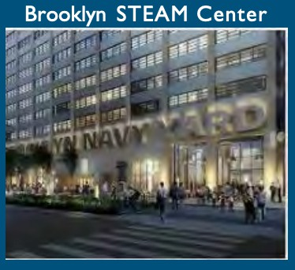






Career and Technical Education (CTE) Options

Slide 23



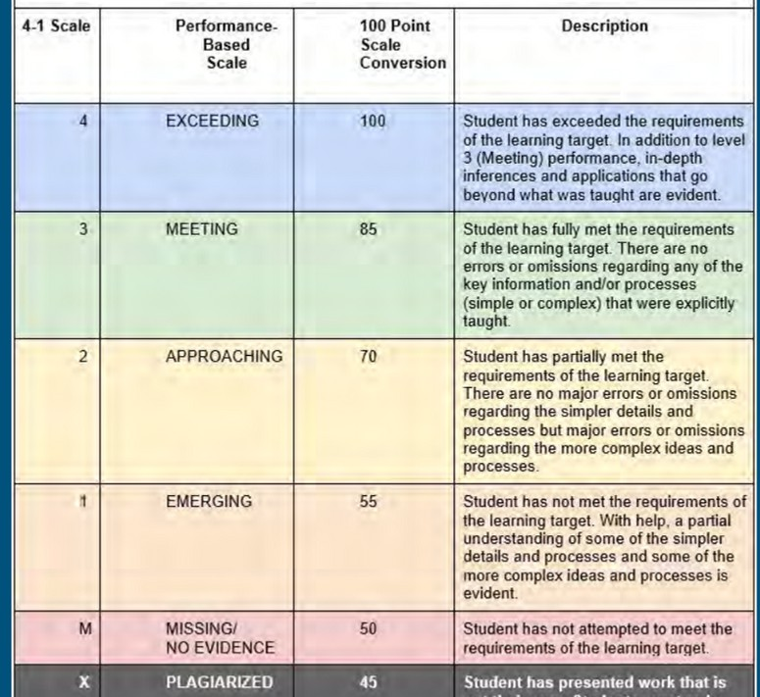

Grading Policy

Slide 24


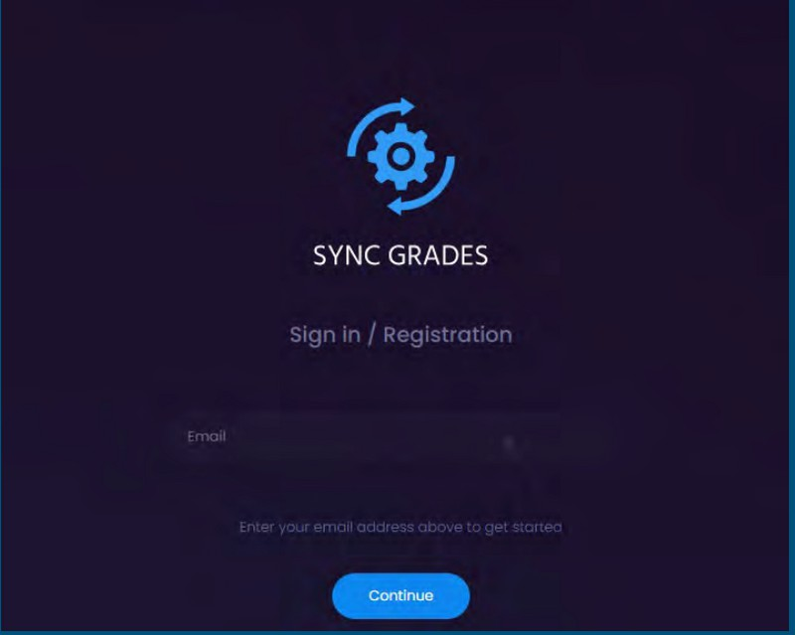

Grading System
We have a universal student information system used to record grades and attendance called Sync Grades.
Parents and Students have access.

Slide 25



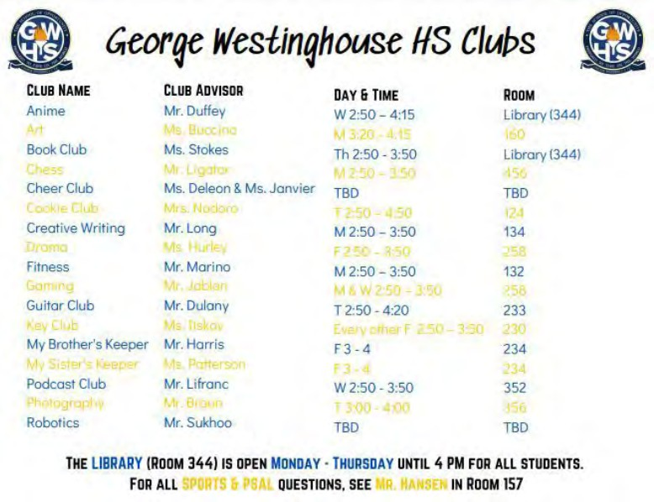
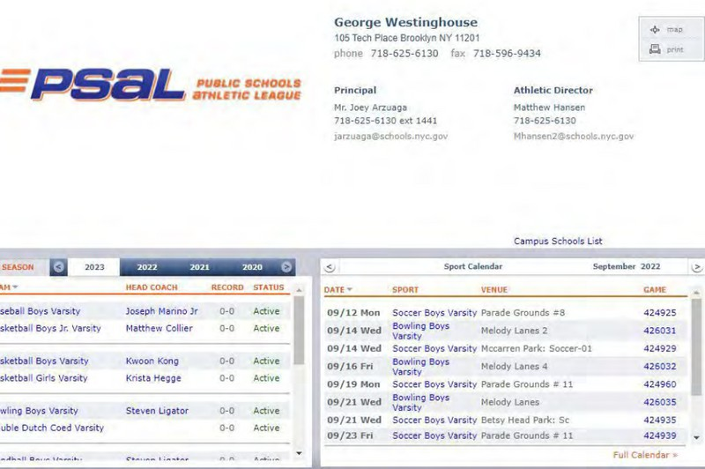

Extracurricular Activities

Slide 26




FIRST Robotics Team 354

Slide 27




G-House Travels
Spring 2025
Stay tuned for more details

Slide 28



Thank you!
Do you have any questions
for us before we go?

